Slide 1
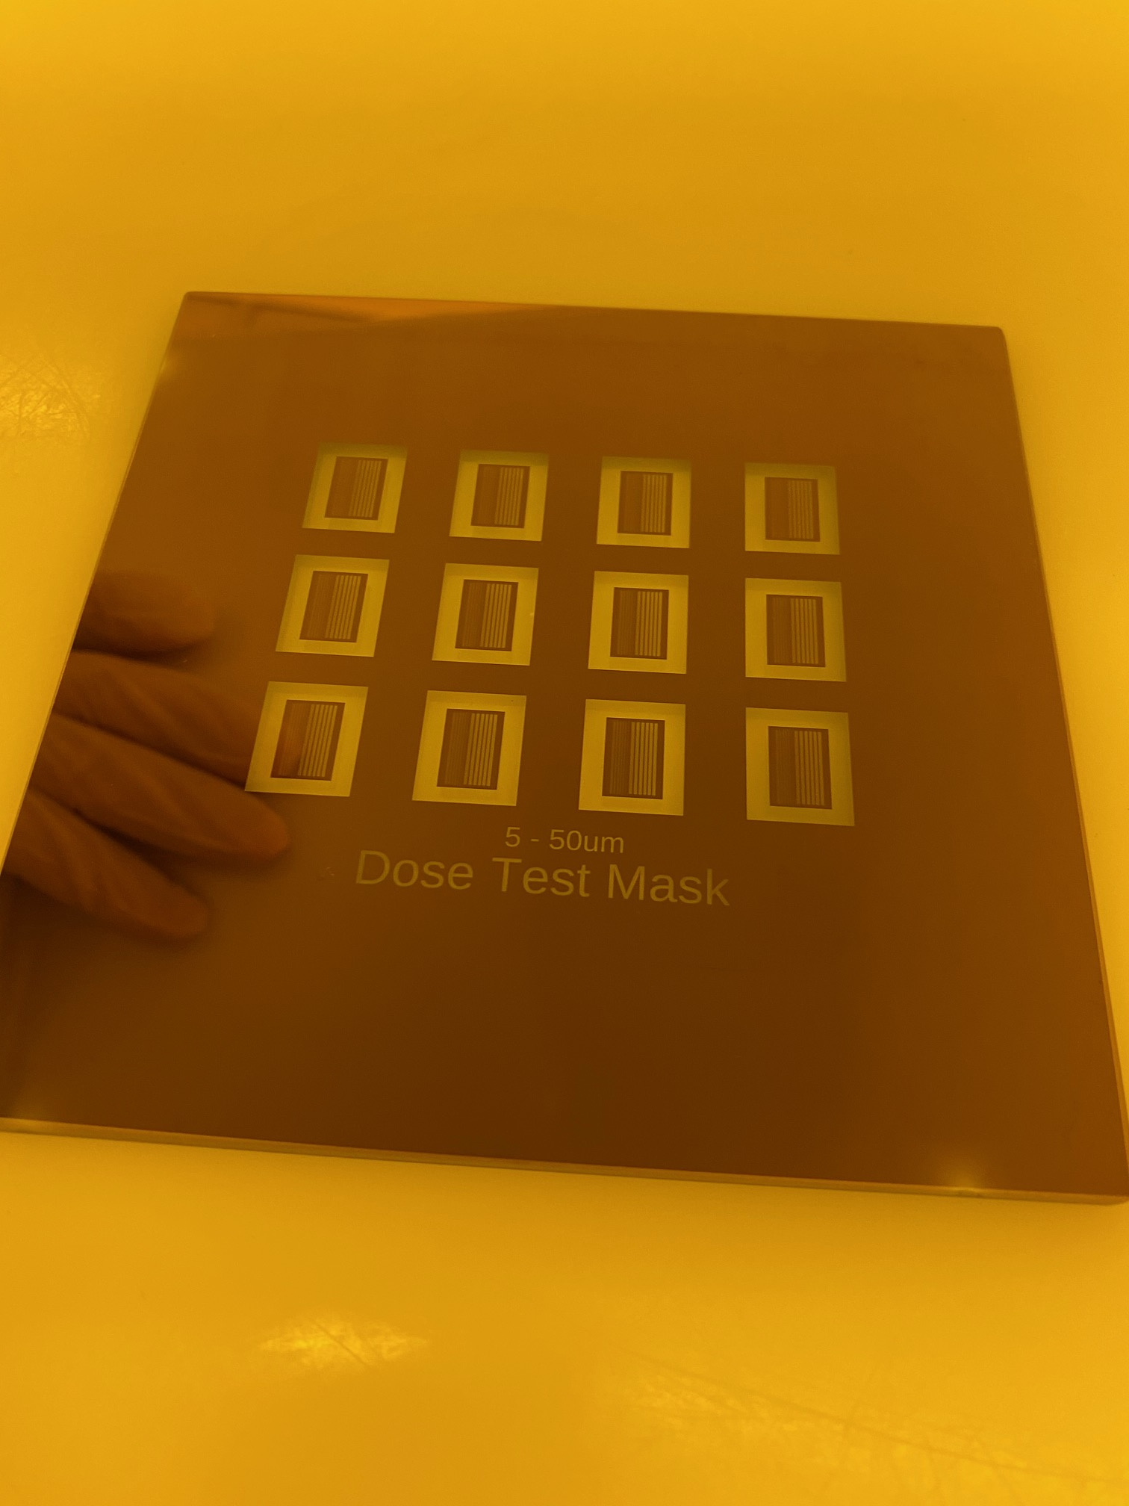
Photomask Creation

Slide 2
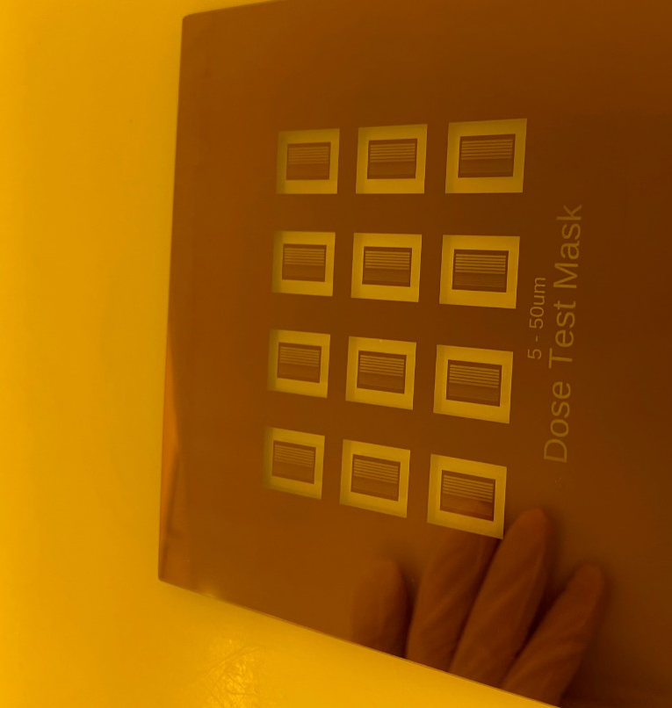
Types of Photomasks used here at the RSC

Slide 3
Chrome Photomask
UV transmitting glass substrate with geometric patterns that are opaque to UV light. Used to transfer patterns to UV sensitive photoresist coatings.
Nanofilm pre-coated photomasks.
Positive Photoresist – 5200A
Chrome oxide – 200A
Chrome – 800A
Soda lime glass – 2.3mm
Exposed and developed positive photoresist
Collimated UV Light Source
Chrome is wet etched and PR removed

Slide 4
Iron Oxide Photomask
Positive Photoresist – 5200A
Iron Oxide 2000A
Soda lime glass – 2.3mm
Exposed and developed positive photoresist
Collimated UV Light Source
Iron Oxide is wet etched and PR removed

Slide 5
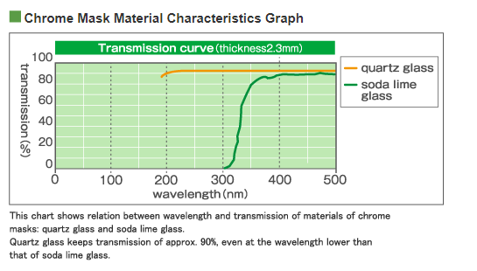
Photomask Blank type available at the RSC
Soda Lime Glass - Used for all RSC masks
4” and 5” available (2.3mm thickness)
Quartz not needed for most applications. Only when shorter wavelength exposure and lower thermal coefficient of expansion needed……
Ref - http://www.mitani-micro.co.jp/en/mask/photo.html

Slide 6
Choosing Photomask Type
Low Reflective Chrome (chrome + chrome oxide)
The Good
Wet etched line edge roughness approx. 50nm
1um minimum feature size
The Bad
Blocks alignment microscope light
Iron Oxide
The Good
Passes alignment microscope light
Harder than chrome
The Bad
2um minimum feature size
Wet etched line edge roughness approx. 300nm
Harder to identify iron oxide side of the mask

Slide 7
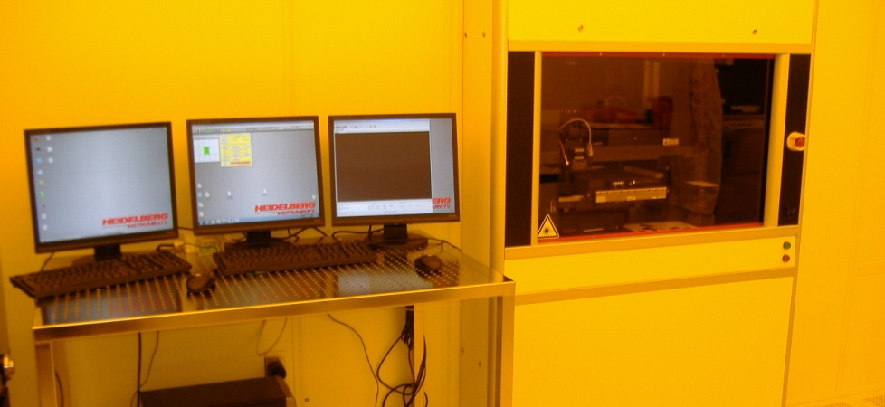
RSC Heidelberg Exposure Tool
Heidelberg Laser Writer – 405nm laser write source

Slide 8
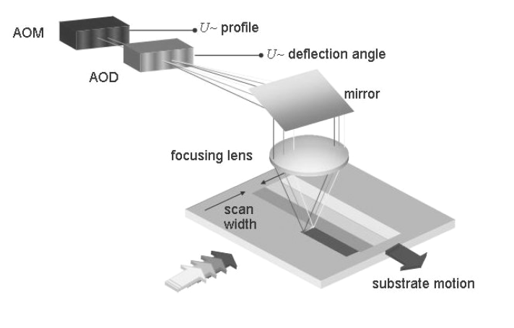
Heidelberg Direct Write Laser System
An ultrafast acousto-optic modulator turns the laser on/off at each pixel as the acousto-optic deflector sweeps the laser across the exposure area.
The stage scans in the Y axis during exposure.
The stage position resolution is 10nm.
Y Axis
X Axis
Basic Optics configuration

Slide 9
Heidelberg Direct Write Laser System
Can expose flat substrate
Repeatable and accurate
Very good focus control via autofocus system
20mm head for ≥ 5um features - DOF=60um
4mm head for ≥ 1um features – DOF=1.6um
Very good overlay/alignment (100nm for 4mm mode)
Design changes on the fly

Slide 10
Consider specs for Heidelberg exposed photomasks
20mm Mode (refers to the focal distance from lens)
Minimum feature size = 5.0 microns
edge roughness = 180nm-3σ,
CD uniformity = 440nm-3σ
Pixel Size = 1000nm
Typical Time = 1 hour , 80mm² area
4mm Standard Mode
Minimum feature size = 1.0 microns
edge roughness = 70nm-3σ,
CD uniformity = 100nm-3σ
Pixel Size = 400nm
Typical Time = 8 hours, 80mm² area
4mm HQ Mode
Minimum feature size = 1.0 microns
edge roughness = 30nm-3σ,
CD uniformity = 50nm-3σ
Pixel Size = 200nm
Typical Time = 16 hours, 80mm² area

Slide 11
CAD Software for Pattern Creation

Slide 12
CAD file formats
GDSII strongly encouraged - The RSC provides use of “Layout Editor” software. Shareware version also available
Klayout is another option – open source
Autocad
may also be used but not recommended. If you insist…..rules must be followed.
Save all files as “AutoCAD revision R12/LT2 DXF format.
.dwg files are NOT supported.
Do not open a .dxf file in a GDSII software such as “Layout Editor” or Ledit” and save it as a GDSII file.
Set units to microns
Use only the following entities: CIRCLE, POLYLINE / LWPOLYLINE and TEXT. LWPOLYLINE is preferred since it’s 2D.
Send the file to Bill Lewis to be converted to GSDII with Linkcad 7 software.
Read Section 5.2 of “NRF Heidelberg DWL66fs SOP” for entire list of rules……

Slide 13
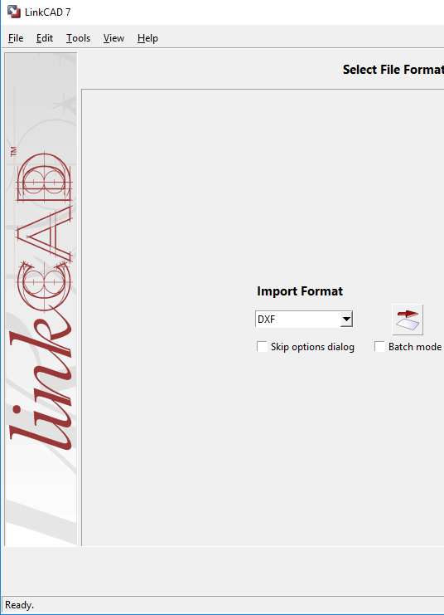
What typically happens when Autocad or Solidworks is used?
90% of all .dxf files I receive have problems
line segments
Nested Polygons
Wrong scale….meters, millimeters, nanometers etc..
Large unusable file sizes
Intersecting polygons
Text labels instead of polygons
Remedy for 50% of issues - convert to GDSii using Linkcad 7 software

Slide 14
General Rules for ALL designs
No intersecting polygons
1
3
1
3
1
1
2
5
3
3
NO
YES
YES
4
2
6
4
2
2
1
2
1
1
No line segments
No nesting polygons
1
2
2
NO
2
1
NO
2
1
4
2
YES
3

Slide 15
General Rules for ALL designs
Text labels are not polygons
Mask polarity should not be a consideration when create your drawing
Heidelberg software inverts pattern
Easy to create
hard to create
Overlap is OK
Mask aligner masks require X mirroring if topside aligned (i.e. looking through the glass side of the mask)
Mirror in X
Align die in straight grids if you will be using the dicing saw and leave room in street for dicing blade i.e. >200um.

Slide 16
“Layout Editor” GDSii CAD Software
Entire device in one gsdii
use “layers” to draw each process layer of the device
“cell” function and hierarchy
Only one circle, rectangle and triangle.
Cell=circle array
Cell=circle (layer 1)
Cell=Photomasks
Cell=rectangle array
Cell=rectangle (layer 2
The rest are all “cell references”.
Sub-sub cell changes impact all downstream cells
Cell=triangle array
Cell=triangle (layer 3)

Slide 17
“Layout Editor” Software Demo
Freeware version will only save to 1000 polygons
Mouse operations
Coordinate display
Snap to Grid
Draw functions (box, free polygon)
Snap to point
Circle – limiting vector points
Selecting polygons and points
“properties” settings
Layer controls for mask device layers
Layer colors/hatching
Boolean operation

Slide 18
Software Demo
Inserting single cell reference
Inserting Array cell reference
Flatten cell to allow edit of array
Moving polygons or cell refs. Use “move by” function = “right click, move, m, shift+left click”
Example of nested polygons
Use separate non-working layer to make layout boundaries

Slide 19
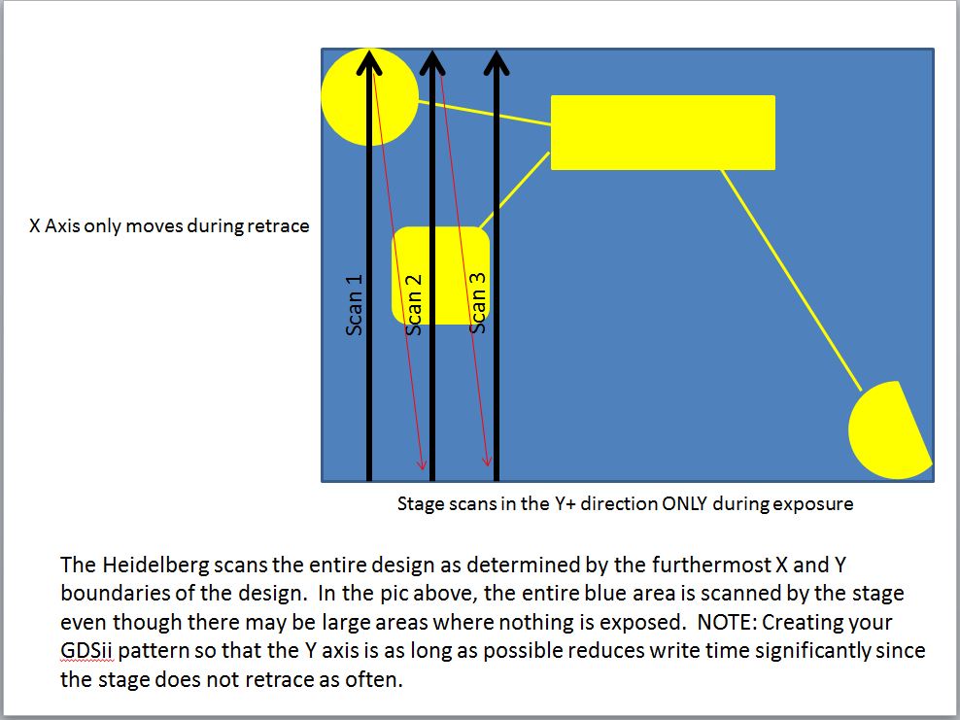
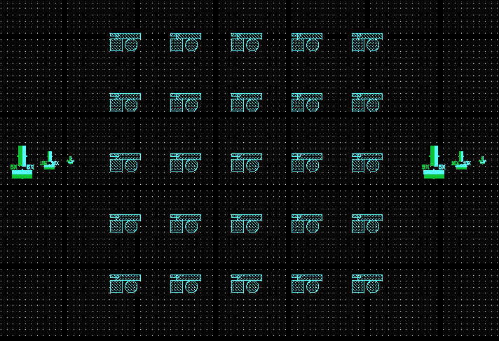
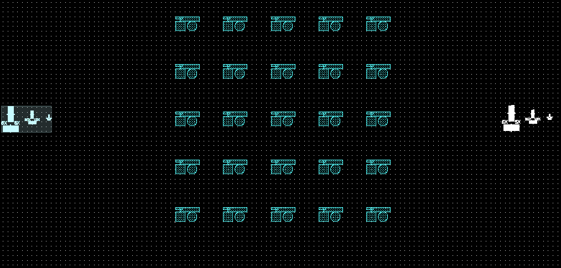
Design Layout Affects Cost

Slide 20
Requesting Masks
or
Training to make your own mask

Slide 21
Making your own masks
Sign up for Heidelberg training
Create your design using Layout Editor
Submit the design via email to walewis@ufl.edu
Request masks from NRF Staff, email walewis@ufl.edu the day before.
Expose, develop, etch, inspect, strip PR.
Staff Making your mask
Create your design using Layout Editor
Submit the design via email to walewis@ufl.edu for review
Fill out “Staff Processed Photomask Request” form which is located on the “Docs” screen of the RSC Heidleberg web page. Email form to walewis@ufl.edu
If everything looks good, “Request Service” on the RSC web page.

Slide 22
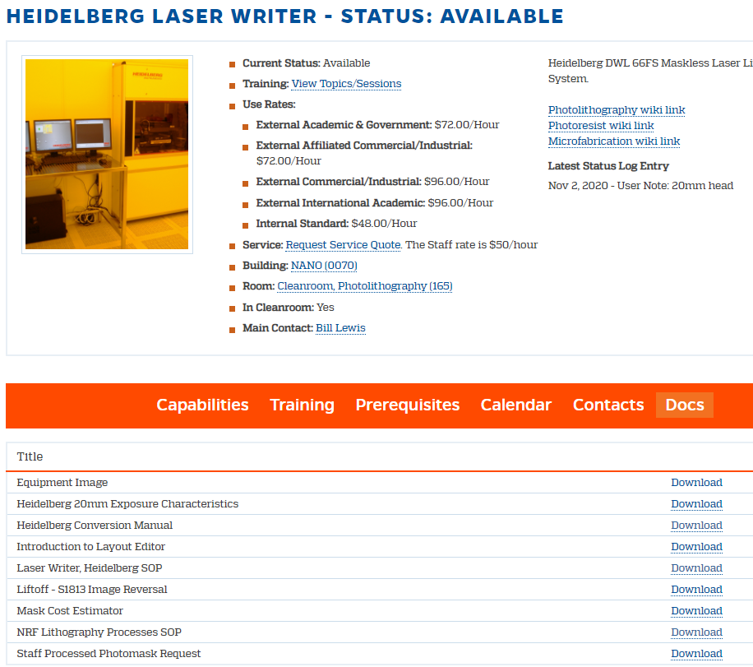
Information Resources

Slide 23
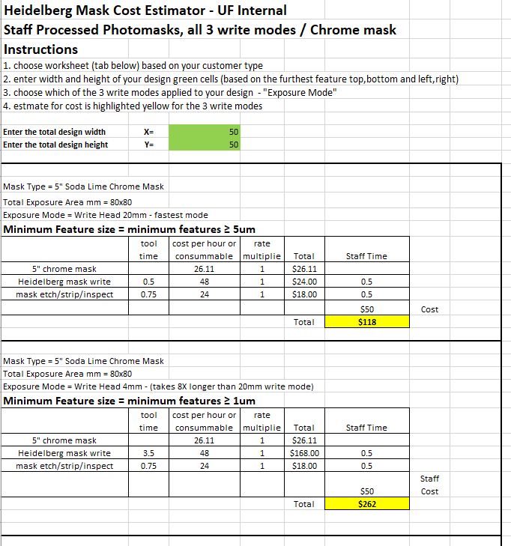
Mask Cost Estimator

Slide 24
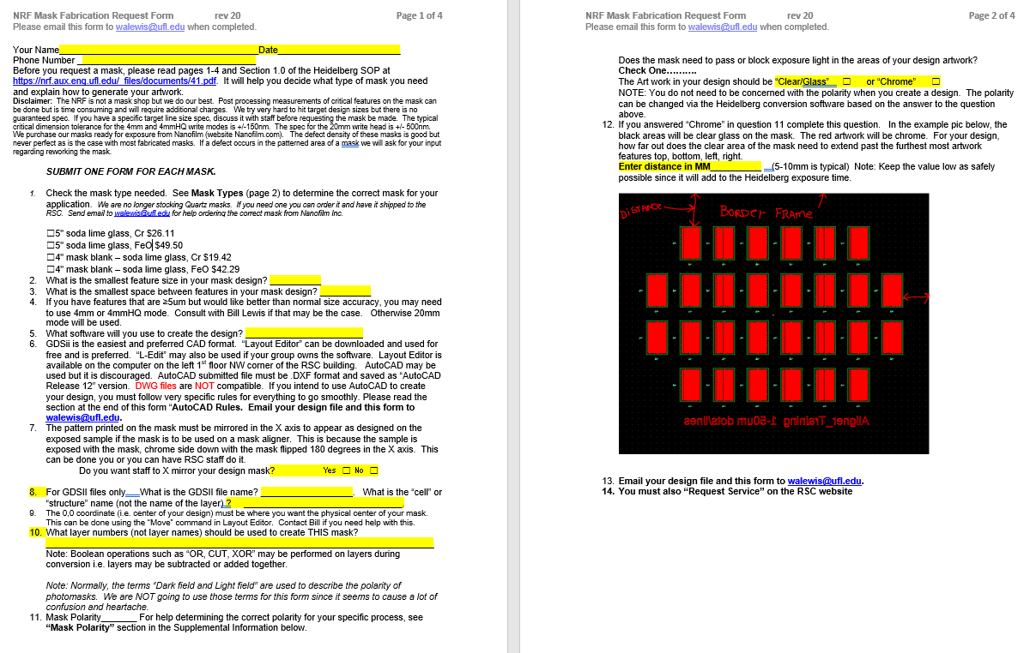

Slide 25
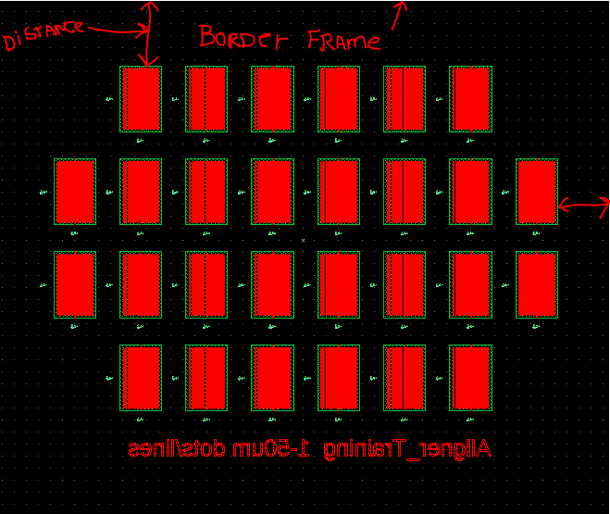
When the design is inverted during conversion – use “Frame” parameter.

Slide 26
Do you really need a Photomask?

Slide 27
Mask or Direct Write (<2um thickness and 405nm sensitive materials ONLY)
Min Feature sizes <1um?
Raith E-beam writer
Start
Yes
Min Feature size 2-5um
No
No
Min Feature size 1-2um
Heidelberg Direct Write Laser Writer
No
Yes
Yes
Consult with NRF Staff
Will layer be reproduced > 3 times
No
Yes
Make mask using the Heidelberg Laser Writer
Expose on Mask Aligner

Slide 28
Photomask Design Considerations

Slide 29
Mask Aligner Expectations
Feature resolution
minimum resolution? It depends
Suss MA6 Mask Aligner = 1um with good planning
whole 4” flat substrates are your best bet
Process bias considerations
Consult with NRF Staff if you are planning on printing <4um features.
Overlay alignment tolerances
Consider layer-to-layer alignment tolerance. You should design your pattern with a tolerance of at least 2um overlay error when possible.

Slide 30
Allowable Alignment Mark Positions
Typical Aligner Overlay Setup
100 mm
5” Mask
Alignment Microscope Objective Lens
Area of Microscope Travel
Range of motion for the alignment microscope is limited, so
alignment marks must be within
A specific window on the mask.
40 mm
70 mm
The closest spacing for the Suss MA6 5x and 20x objectives is 40mm. The MA6 is also equipped with a 10x “offset” objective. The min spacing for it is 8mm.
EV620 Objective range
•Top side objective travel range: x direction 30 - 150mm separation, y direction +-75mm; z direction +-5mm
•Bottom side objective travel range: x direction 30 - 100mm separation (8-100mm optional); y direction +-12mm, z direction +-5mm

Slide 31
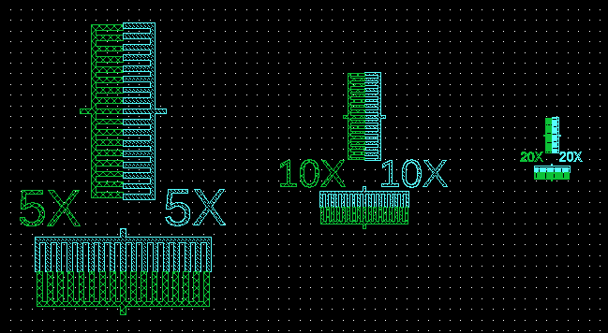
Alignment Marks
Vernier arrangements for alignment marks are preferred. Staff can provide a GDSII file for the structure below.
The step pitch difference of the fingers are used to measure mis-alignment.
Layer 2
Layer 1

Slide 32
Alignment Marks – (cont)
Chrome mask alignment marks
You will have to look through the mask via the alignment microscopes to hunt for the alignment marks on your device. The field of view of the CCD image for the 5X objective is 850um. It’s best to have as much of that field of view clear as possible so you can find the wafer alignment marks.
 | Alignment Objective | Approximate Split-field CCD window in um
Suss MA6 | 5X | 850
 | 10X | 380
 | 20X | 210
EVG 620 | top 10X | 350
 | bot 10X | 350

Slide 33
Will you be able to see alignment marks on your device?
Consider the affect of processing steps between mask layers. How will the addition of films affect the visibility in the alignment microscope?
Thick Aluminum
Alignment Mark may not be visable
Top down light diffracts off the step edge to create edge shadow
Thin conformal films are usually visible using top by top alignment down microscope
Thin Aluminum

Slide 34
Process considerations for masks

Slide 35
Mask Layout for Plasma Etch tools
No pattern zone – edge exclusion width for STS DRIE= 12.5mm------needs PR protection
Safe area for pattern 90mm standard. 75mm for DRIE
Edge exposure or PR removal for Unaxis etcher 8mm around edge----No PR. Design this into your mask!
wafer
Unaxis ICP Wafer Clamp
Etcher Electrode

Slide 36
Mask Bias
Feature Size Bias
Litho Bias
Mask Size vs. Actual PR Size
Plasma Etch Bias
Plasma etch erosion of photoresist mask sidewalls may affect slope and roughness of the target material sidewall.
It may change final feature size.
The mask may need to be “biased” to compensate for the feature size change.

Slide 37
Mask Bias
Wet Etch Undercut
1um etch = 1um undercut
Resist
Lateral loss is almost as much as vertical.
Mask writers usually have an option to bias the design size to compensate. On the Heidelberg Laser Writer, “spotsize correction” X and Y can be used to do this within limits as determined by pixel size.
How can I determine bias for my process?

