Slide 1
Image Reversal Liftoff Process – Heidelberg Exposure
Metal thickness 3000A Cr

Slide 2
Process Flow
bake | 125C, 15 min
HMDS | std process
S1813 Suss spin IHD | F1813_1.23 or F1813_2.0
bake cee HP | 2 min @ 112C
Heidelberg Exposure-Negative image
YES Image Reversal | recipe 2
Flood Expose MA6 | 60 sec
Develop | 4:1 - 400K develop
Asher | 2 min - 400W - 600sccmO2
PVD Ebeam Evap | 3000A Cr

Slide 3
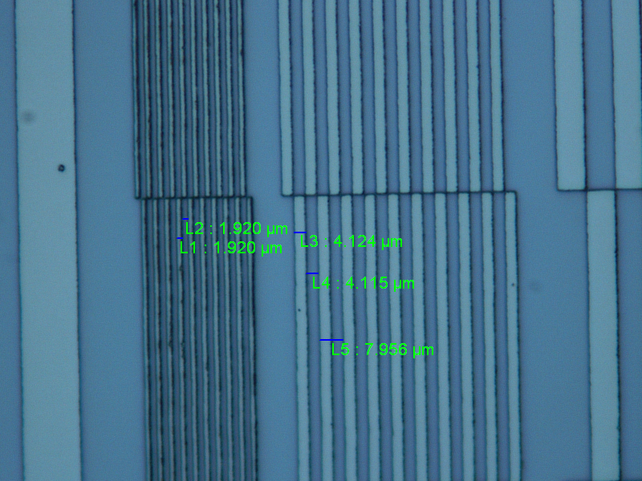
Wafer 1 – 1.23um S1813 - 4mm HQ expo mode
Filter 30%
Best focus 1100
Best Energy 30
Post liftoff

Slide 4
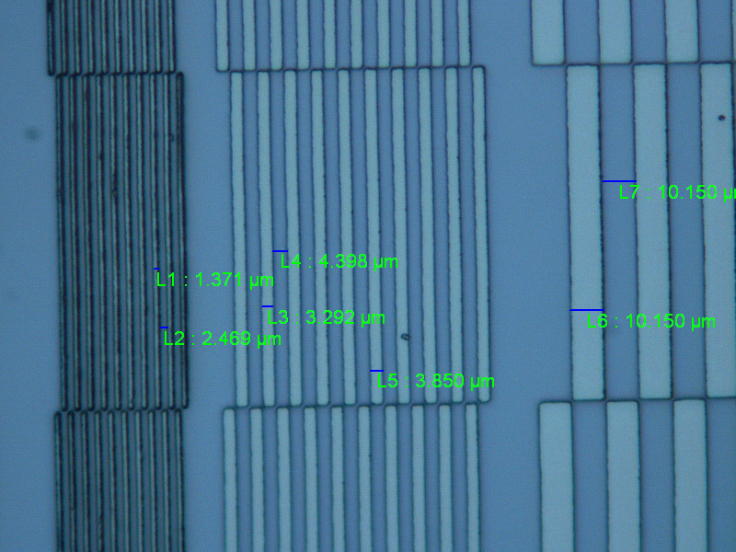
Wafer 1 - 1.23um S1813 - 4mm standard expo mode
Filter 30%
Best focus 1100
Energy 60
Best energy was not exposed for this test (i.e. didn’t go low enough). At E60, it’s overexposed. 2um line came out 1.4um
Best exposure will be E40 or E50 to size 2um lines.
Post liftoff

Slide 5
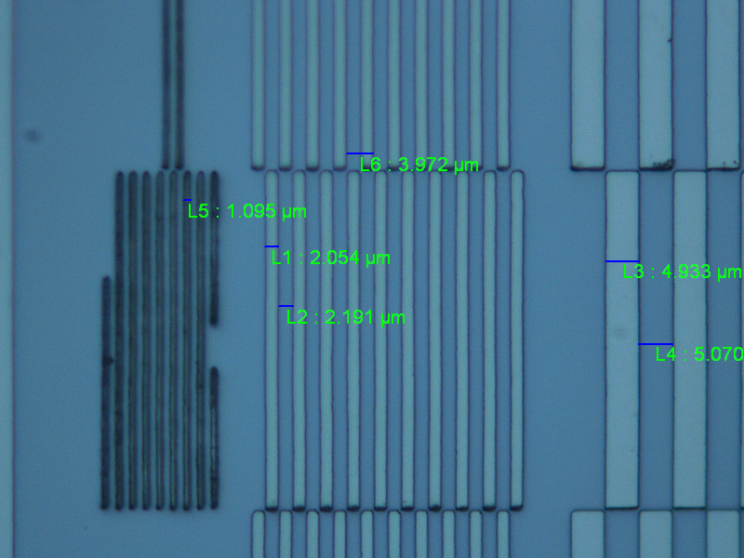
Wafer 3 - 2.0um S1813 - 4mm standard expo mode
Filter 30%
Best focus 1100
Energy 70
Post liftoff

Slide 6
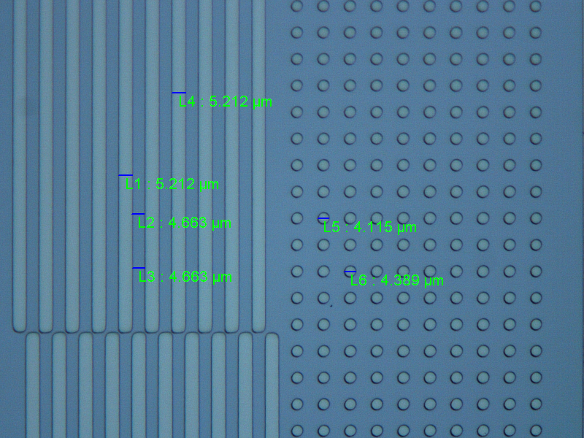
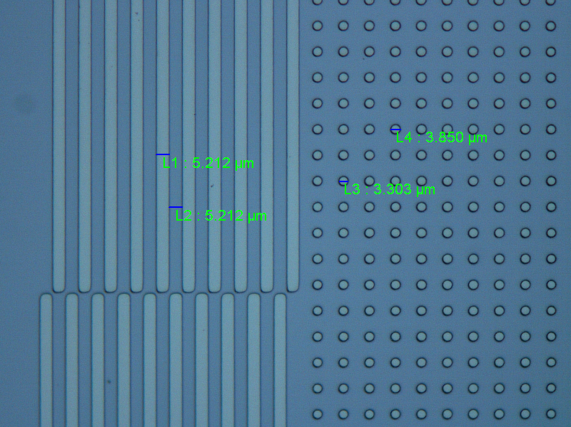
Wafer 2 – 1.23um S1813 - 20mm expo mode
Filter – none
Best focus - NA
Energy 140 and 160
Energy 70 X 2 passes
Energy 80 X 2 passes
Post liftoff
Post liftoff

Slide 7
Observations:
Slight defocus (approx. 200 from best)gives slightly cleaner liftoff with marginal change in sizing.
1.23um PR is adequate for 3000A metal thickness.
20mm feature sizing good without bias using the correct dose.

