Slide 1
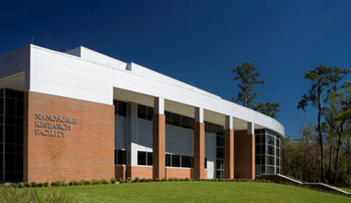
Nanoscale Research Facility (NRF)
Covering the basic safety knowledge and facility protocol required before we can grant access to our facilities

Slide 2
All safety information provided by NRF Staff, including this document and the NRF Safety Training class is supplemental to the UF EH&S Lab Safety Program.
It is your responsibility (with the guidance of your Principal Investigator, or PI) to read and conform to the EH&S UF Laboratory Safety Manual, and the EH&S UF Chemical Hygiene Program at all times while using NRF facilities.
The UF EH&S web site can be found at http://www.ehs.ufl.edu/ .
All UF EH&S Training must be done BEFORE beginning work in the any NRF Facility.
All users need Hazardous Waste Management Training (annually)
Cleanroom users also need HF training (once every 2 years)
NFMCF users will additionally need radiation safety training
Process equipment specific Safety Instructions are included at the beginning of each Process Equipment SOP and will be covered by the hands-on training provided for each tool by NRF Staff. NRF Equipment SOP’s are usually located on the individual tool webpage under the Documents tab. SOPs are available at the physical tool location.

Slide 3
General safety philosophy of the NRF
With in the confines of the NRF facilities there is a three-tier philosophy for safety
Personal health and welfare. Many of our rules and restrictions are directly related to ensuring that all facility users, staff, and visitors stay safe.
Process safety. The NRF is by nature a multiuser multidisciplinary facility. Because of the criticality of the research and the oftentimes sensitive nature of a tool or of a process, many of our directives are related directly to protecting everyone’s research from failure.
Facility safety. The NRF is a highly automated and sophisticated building; misuse and improper procedures can severely damage the facility.

Slide 4
Building Hours
All users begin with Basic User status, with the TUMI and door access available 8am-5pm M-F excluding university holidays.
The TUMI will not auto log you out at 5pm, you must remember to wrap up and log off before 5pm.
There is no grace period on door access, they lock at exactly 5pm.
Guests are welcome during business hours*
Extended hours are available by application.
After Hours Access (AHA) extends the access to the building to 7am-10pm, 7 days a week once approved.
The application is on the NRF webpage under forms.
AHA users are required to use the e-buddy check-in system.
No Guests or visitors without written preapproval.
*You must remain with your guest as you are responsible for their safety. Guests may not operate tools or NRF computers

Slide 5
Activation of GatorOne for Door Access
There are 3 options for access, you will need to notify us of which method you have active or would like activated in the access system. UF plans to limit each person to 1 method for door access campus-wide.
Use your physical NFC enabled UF ID card, these were issued beginning February 2023, if your ID card is older than this you’ll most likely need to request a new card at the Gator One office in the Reitz Union or Shands.
Use the mobile wallet on your phone (Apple pay, Google or Samsung wallet) – Your gator one ID must be loaded to the wallet before we can active this method, note it can take up to an hour for this method to appear after you load the card.
  *If you upgrade to a new phone, or factory reset your device you will need to request a reactivation in our system after adding the UF ID to your new mobile wallet. This can be done via email.
3) Use your smart watch (currently only Apple watch is compatible, Samsung and Google “coming soon”). All the same limitations for a phone apply to a smart watch.
Setup instructions can be found at: https://businessservices.ufl.edu/mobile-gator-one/

Slide 6
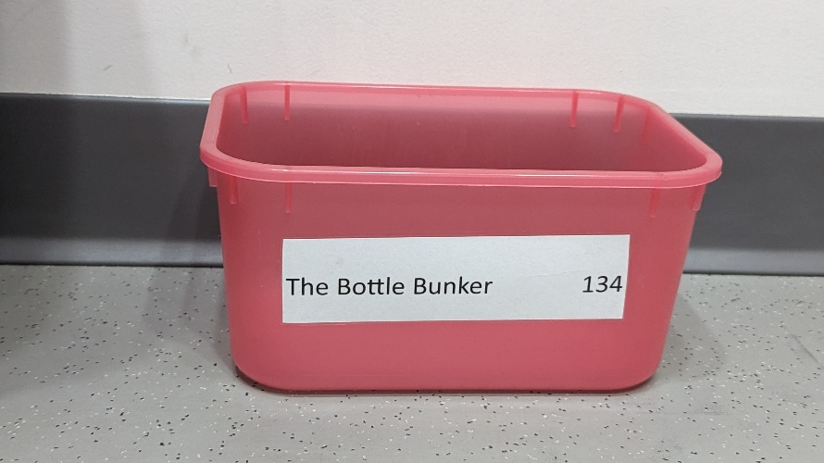

Food, Drinks, and Backpacks
Open food and or drink containers are prohibited in all lab spaces. Closed top drink containers may be used in some characterization areas. When these drinks with a lid are allowed, there will be a red bin to store it in. No bin = No drinks allowed
Do not dispose of empty food containers in the labs.
Leave open food or beverage containers in the hallway next to the lab door, or at the tables or counters in the common areas at the NW corner of each floor.
Backpacks are welcome in most lab spaces, but should be placed in a basket, under a counter, or a location away from walkways. Please do not place backpacks on the lab counters or chairs.
**Bags and backpacks are not permitted in the cleanroom, we have day use lockers for your bag.**

Slide 7
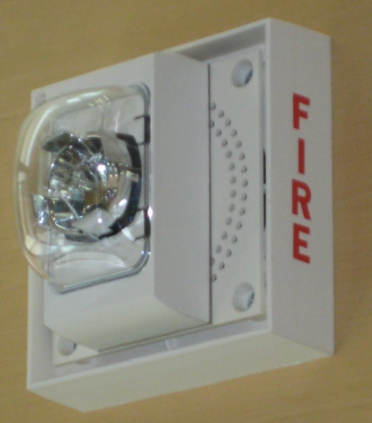
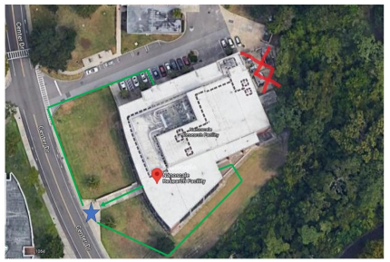
  Fire and Hazardous Gas Detection System
  GENERAL. There are flashing white strobe lights and voice speakers for visual and audible annunciation of alarm conditions (Fire and/or gas detection).
  If you hear an alarm message over the speaker system AND see the white flashing strobes, IMMEDIATELY stop all activity and exit the building.
  (If you are wearing hazardous materials handling PPE, quickly decontaminate first, and close hood sash.)
  Gather outside the building at bottom of the stairway at the main entrance to NRF. If you are in the clean room, proceed directly out of the gowning room, through the lobby, and out the West entrance doors. Do not stop to remove your cleanroom garments or PPE.

Slide 8
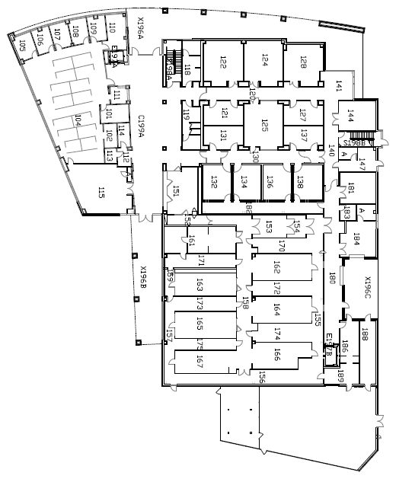
EVACUATION ROUTE MAPS ARE DISPLAYED IN ALL OF THE MAIN HALLWAYS
After you have evacuated from the building and gathered at the main entrance / stairway, do not leave the area until everyone has been accounted for. If you have knowledge of the incident or any helpful information please step forward and speak to one of the staff members, UPD officers, or firefighters. You can reenter the building only when you hear an ‘All Clear’ message from a staff member or firefighter.
GATHER
ON STEPS
EXIT PATH AND DIRECTION
POST ALARM MEETING
AREA
START HERE
FIRE EXTINGUISHER
EYEWASH STATION
For all evacuation routes, the building gathering point is on the outside main building steps (west side of building). The service drive/parking lot is to remain free of evacuees in the event emergency vehicles need to gain access.

Slide 9
CLEANROOM HAZARDOUS GAS ALARMS
The NRF was designed with separate air handling and exhaust systems for the cleanroom, isolating it from the rest of the building. If a gas leak is detected in the cleanroom, only the cleanroom and north service hallway are evacuated. The alarm message over the speaker system and white flashing strobes will activate only in these areas.
Each tool in the cleanroom using hazardous gas has orange strobes near the tool on the bay and chaise sides. These strobes will flash to alert you that a gas leak has been detected in the area. If you are in the cleanroom or north service hallway, follow the procedures and evacuate the cleanroom.
If you are in the office areas or lab areas, THE WHITE STROBE LIGHTS WILL NOT FLASH.
You are not required to evacuate the area and may continue working.
A warning message will sound over the speaker system to alert staff of the problem.

Slide 10
REQUIRED PERSONAL PROTECTIVE EQUIPMENT (PPE)
Safety Glasses
Safety glasses must be worn at all times in the NRF clean room spaces.
The only exception will be when looking through microscope objectives (remember to put them back on afterwards).
Characterization Lab spaces do not always require safety glasses, but safety eyewear is ALWAYS prudent. When in doubt wear your safety glasses! Realize that what you don’t know can hurt you.
Imaging Lab spaces (SEM/TEM) do not require the use of Safety Glasses.
If a room contains equipment used for handling hazardous material or processes, then all occupants of the room must wear safety glasses.
Shoes and street clothes
Full Coverage Shoes are Required when working in any of the labs: sandals, high heels, open top, open toed and open heeled shoes are prohibited inside NRF lab spaces. Your shoes must completely cover your feet when accessing any of the laboratories.
Short pants, skirts and dresses may not be worn while handling hazardous liquid chemicals (including cryogenic liquids).

Slide 11
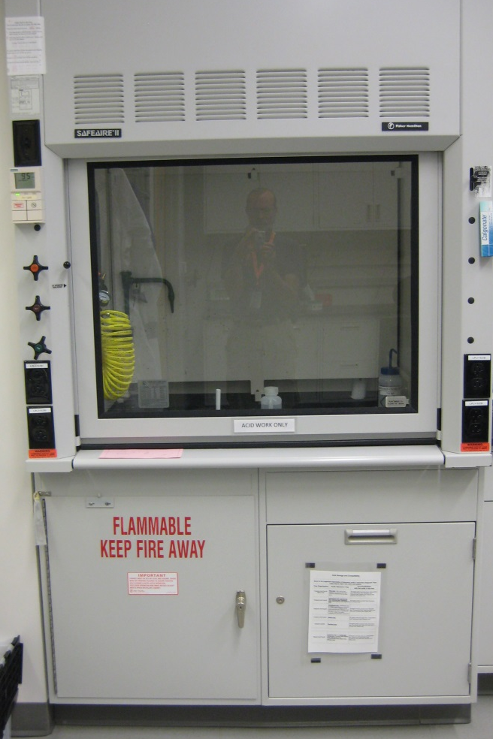
    Chemical Hoods
Each NRF lab is equipped with a hood, and most are available for use as needed. Please abide by any signage indicating that a hood is not available.
Fume hood airflows at 100 lfm are designed to stay laminar, but airflow can be easily disrupted. Turbulence can bring fumes back to you. Avoid making rapid movements while working in a fume hood and avoid walking close to a fume hood that is in use.
All hoods should be checked for proper function and set up. Green light on, air flow indicator reading at ~100 lfm, storage area stocked with enough stock chemicals, and finally a certified and dedicated satellite waste collection site.
NRF hoods are equipped for ease of use with flow sensors, flipable air foils to allow cables and tubing easy entry, and door height guides.
Use secondary containment inside the hood to prevent spilled materials from reaching the drain, or any incompatible mixing.

Slide 12
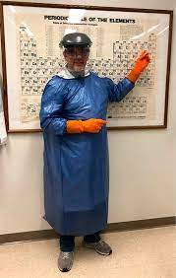
    Personal Protection Equipment (PPE) Required when using a hood for acid / base processing
The following is a list of personal protective equipment required for use of any hood when working with concentrated acids or bases:
Long pants, full coverage shoes
Full length vinyl apron with attached sleeves (blue)
Long chemical resistant gloves (orange)
Full face shield
Lack of appropriate PPE use is very dangerous and will result in suspension of access to the NRF
Please report PPE violations to the non-compliant user or to NRF staff (you can even use our anonymous tip link)

Slide 13
  Non-NRF Chemicals
An accurate inventory of all hazardous materials must be maintained by the facility. You may not bring chemicals or substances of any type into the NRF without approval of NRF Staff. Please make an appointment with Staff if you would like to use a substance not already approved for use in the NRF. A Materials Request Form must be completed and submitted to staff for approval. If approved, you will be shown where to store the substances inside the facility. It is possible that the material may not be compatible with facility storage or waste stream and require an additional approval of transport method for the material and its waste products. New chemistry may also have adverse effects upon other standard processes or damage common use equipment. Check first!
ABSOLUTELY NO CHEMICALS MAY BE LEFT NEAR EQUIPMENT (INCLUDING WET PROCESSING HOODS) INSIDE THE ANY OF THE LABORATORIES WITH OUT SPECIFIC STAFF APPROVAL AND SIGN OFF. VIOLATORS WILL LOSE ACCESS TO THE FACILITY .

Slide 14
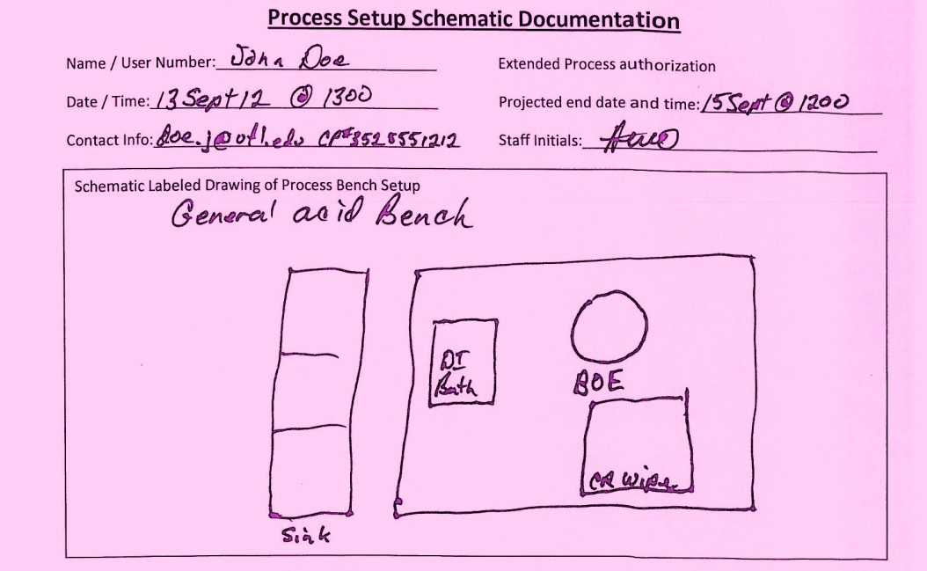
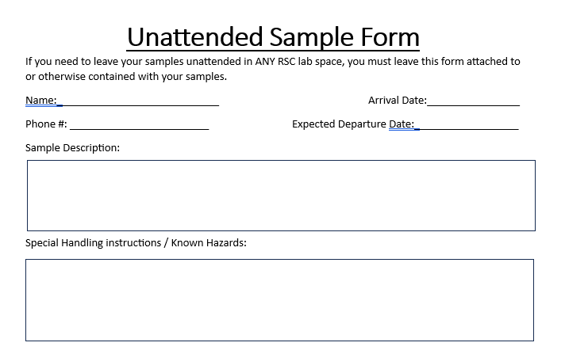
    Unattended Processes and/or Samples
Check the time; concentrated acid and base use can only occur between 8 am and 5pm on official UF workdays. Concentrated acids/bases should never be left unattended.
Pink Process Forms:
Place a process documentation label in or near the work area stating user contact information and date and a schematic diagram of the experimental set up with the chemicals listed. If containers cannot be labeled during your process, you MUST use a pink process form.
Yellow Sample Forms:
Generally, samples should not be left unattended or overnight in our facility. In some situations, this is necessary. If samples MUST be left unattended in any of our labs, they need to be accompanied by an unattended sample form identifying what the sample is, who it belongs to, and when it will be picked up.

Slide 15
Make sure that you also have everything you need before any reagents are dispensed
-waste bottle(s)
-all required samples
-sample containers
-proper forceps for sample handling
-rinse water
-wipes
-any other required supplies
--Retrieving items during processing can create accidents and spread contamination.--
-Know where the closest spill kit and wash stations are located.
-Minimize the quantities of materials that might be involved in a fire or explosion by limiting the amount of chemicals used.
Notes:
Necessary here, or tour talk?

Slide 16
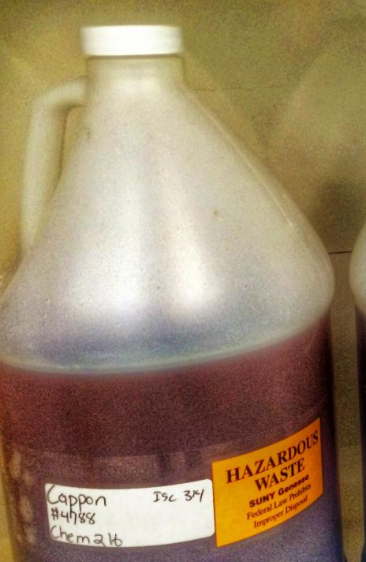
Chemical waste management
Every area that produces chemical waste should have an approved Satellite Accumulation area as close as possible, but always in the same room.
NRF Staff requests regular pickup by EH&S, these will be scheduled so as to ensure that the hazardous wastes are not kept on site for more than a few days and do not build up to greater than permitted quantities.
Each of the bottles are to be individually labeled with an accurate label detailing the name and quantity of all of the material in the container. If at any time the contents of the bottle is changed then the label should be modified on the spot.
The amount of waste to be generated should be known before the process starts and there should be enough waste containers on hand to contain the waste before any reagent is dispensed.
Check waste container levels BEFORE beginning your process, DO NOT overfill waste containers. Full is at 2/3 full (when the level reaches the curve of the bottle not the neck).
Full

Slide 17
Notices, updates and communications
You will receive a variety of emails from the NRF, it is in your best interest to at least open and skim the content for relevant updates or events.
Once a week (usually Tuesdays) we send out a weekly update, this will highlight important facility or procedure changes, give a list of upcoming events and meetings, and give a short safety update or tip.
Tools you are trained on will auto send you status updates when the tool goes down or comes back online for use. Staff will summarize the issue and expected repair time if known in these updates.
NRF administration may send out urgent updates directly to the users list, typically all users and PIs will receive these updates.
Safety violations, Improper tool shutdown or SOP violations: We will notify you of any issues that come up during or after your use. Usually, a warning is given and note posted to your user account. Repeated violations will result in access being revoked.
We also have Teams Channels for processes/tools in the facility, and direct messaging through the TUMI system.
Please, please, please communicate with us. We really want your input so we can keep improving.

Slide 18
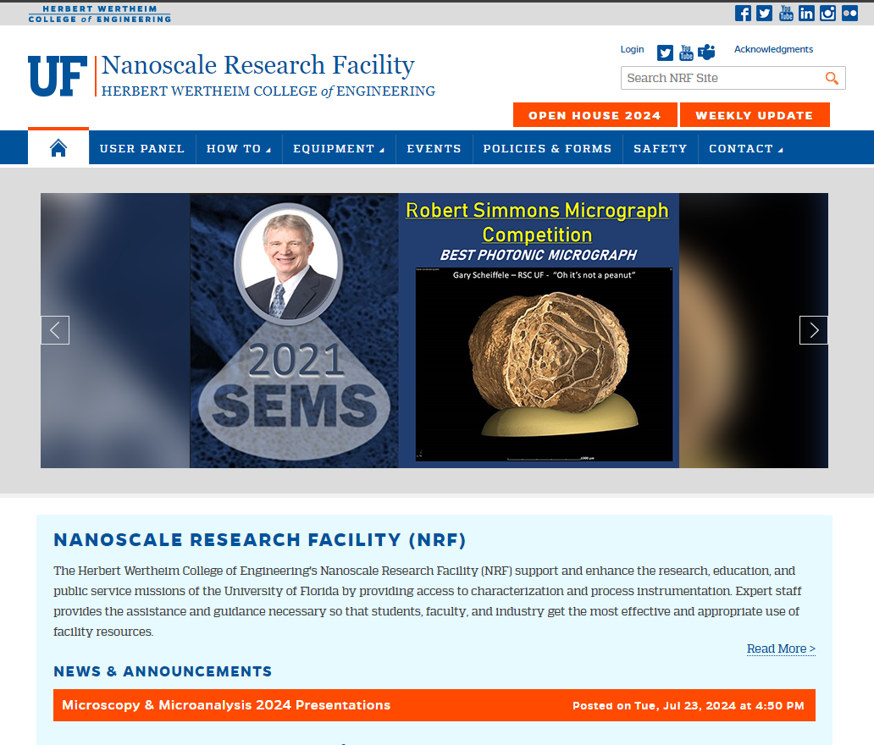
NRF Website
Notes:
Show the user panel, discuss how requests for training/service work, show anonymous tip location

Slide 19
Publication Requirements
It is important to document use of the Nanoscale Research Facility in each publication, poster or oral presentation. This helps us to be recognized by the academic community which in turn facilitates funding and enables us to continue supporting your research. When data acquired at the NRF results in a publication, please contact us to let us know, and acknowledge us in your manuscript using a simple statement template found on our website.
If NRF staff members make significant intellectual contributions to your work, please discuss co-authorship opportunities with your PI and our staff member(s), this is extremely beneficial to our staff as research scientists.

Slide 20

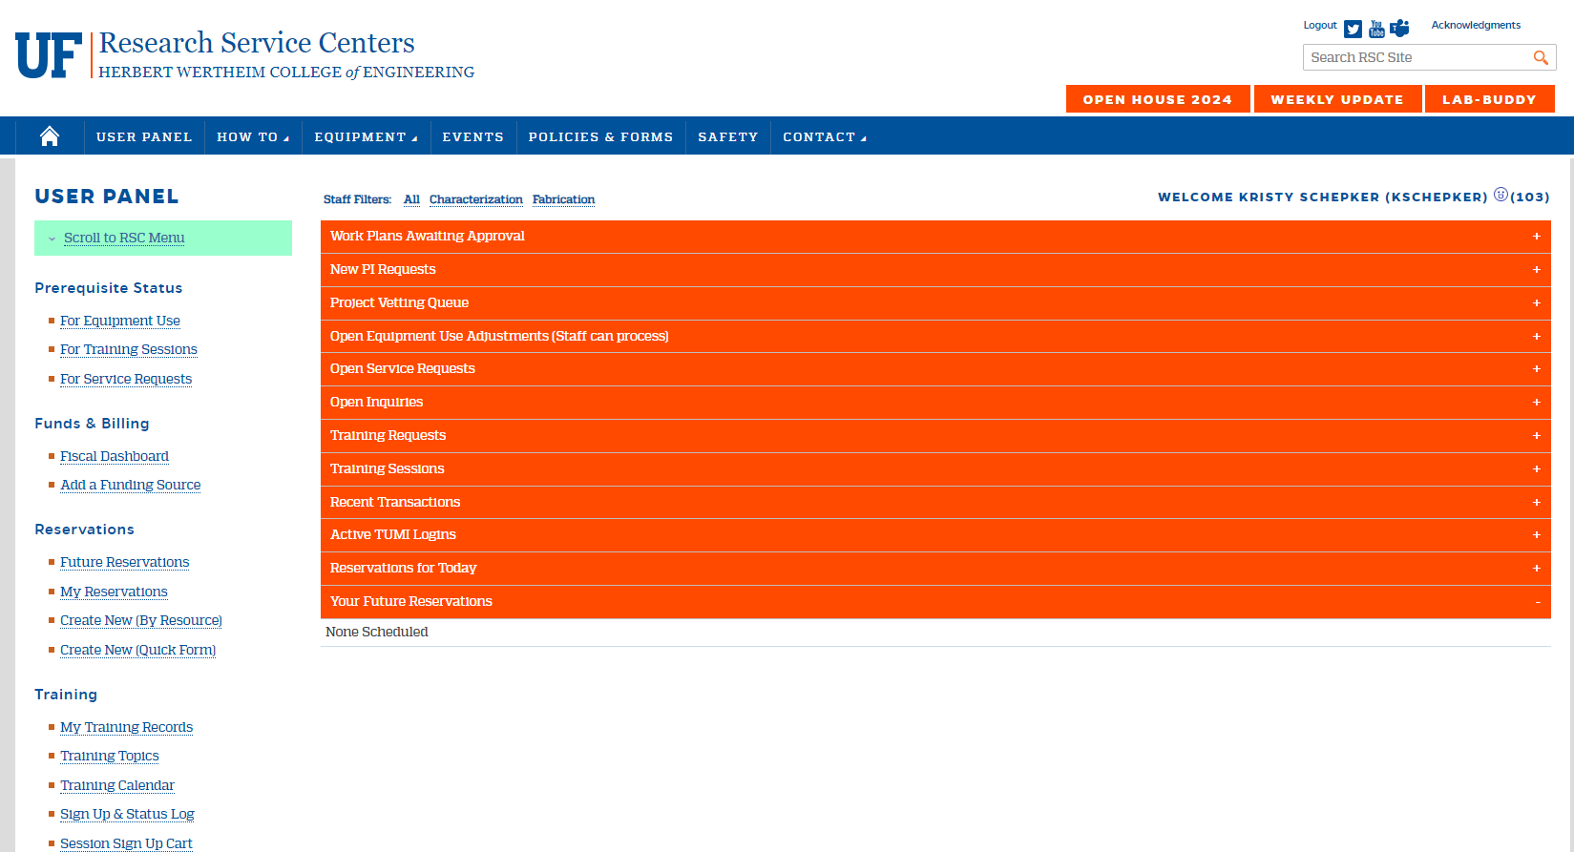
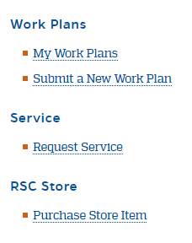
User headers to pay attention to:
Service Requests
Reservations for Today
Your Future Reservations
Recent Transactions

Slide 21
Using the NRF TUMI System
(Tool – User – Machine – Interface)
The kiosks that control tool interlocks may be situated in the lab with the equipment or be in a central location controlling instruments in multiple labs.
We bill based upon time used from TUMI login to TUMI logout.

Slide 22
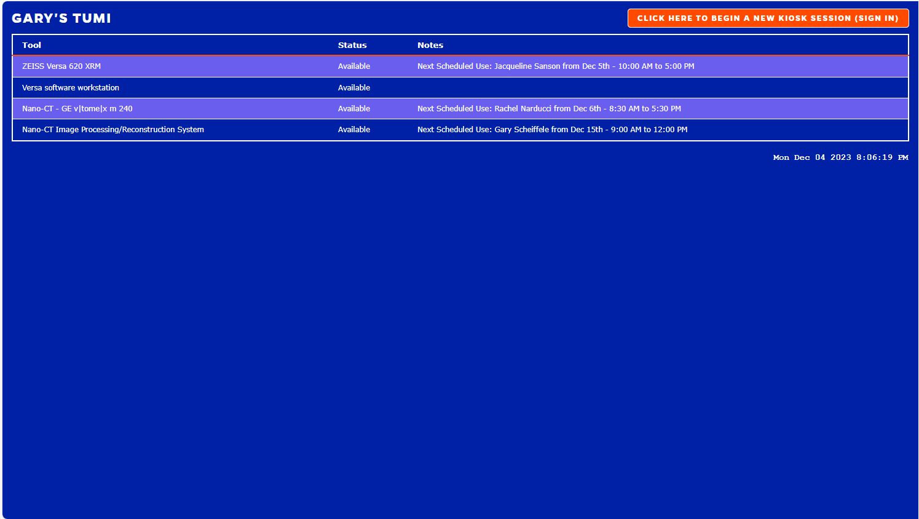
Before you log in, you can see a list of the tools this TUMI station is controlling, and the status of each tool.
Dual Login. First the TUMI, then the tool.
Any upcoming reservations will appear here, it is not a requirement to have a reservation, but be mindful of upcoming reservations to ensure the tool is available at their reserved start time.

Slide 23
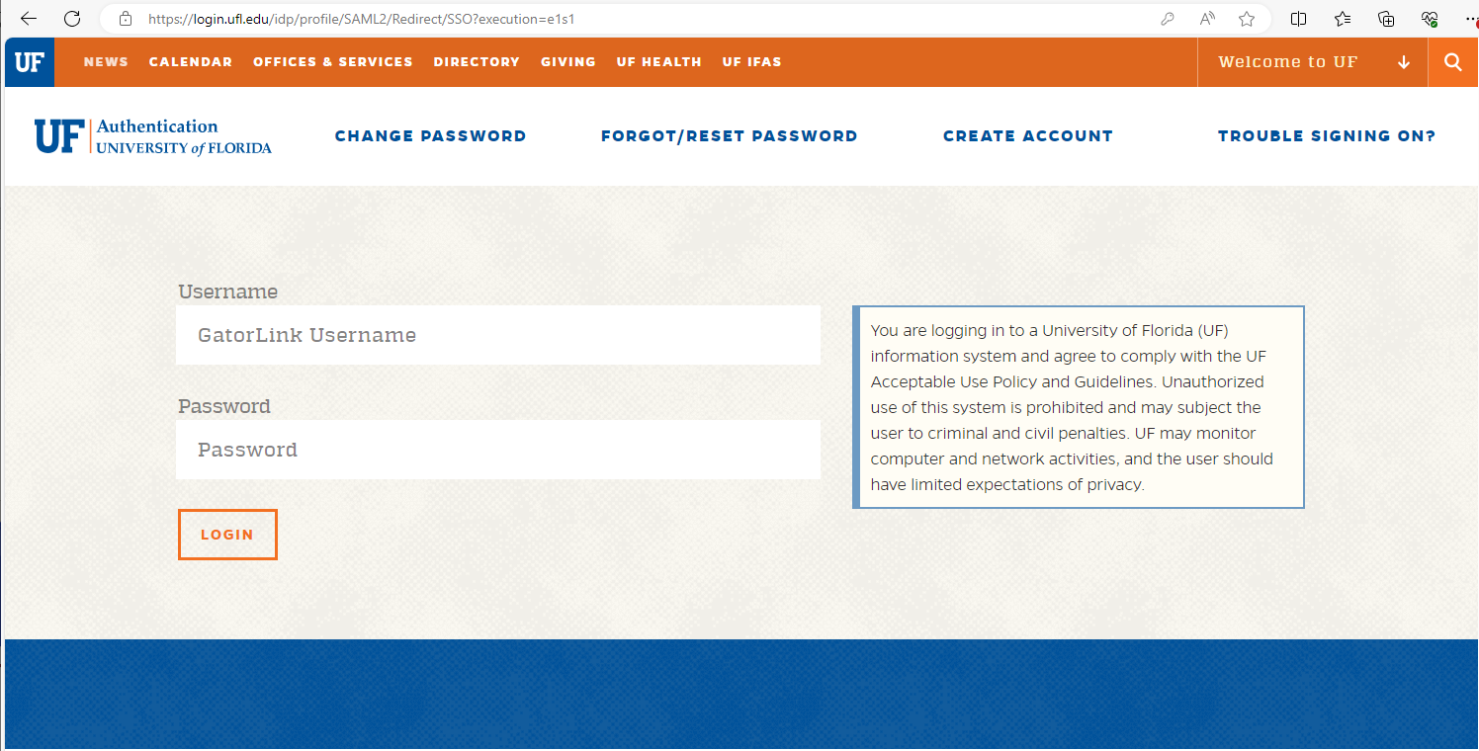
Log in with your Gatorlink, dual authentication will be required.

Slide 24
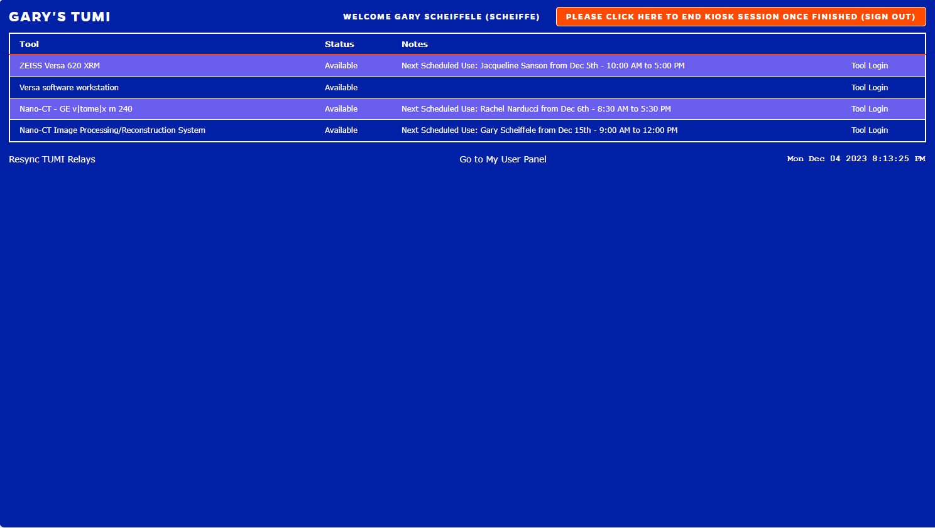
If you have not been trained on a tool or training has expired for any reason, you will not see the “Tool Login” option on this list.
Select the appropriate log in button begin using the tool.

Slide 25
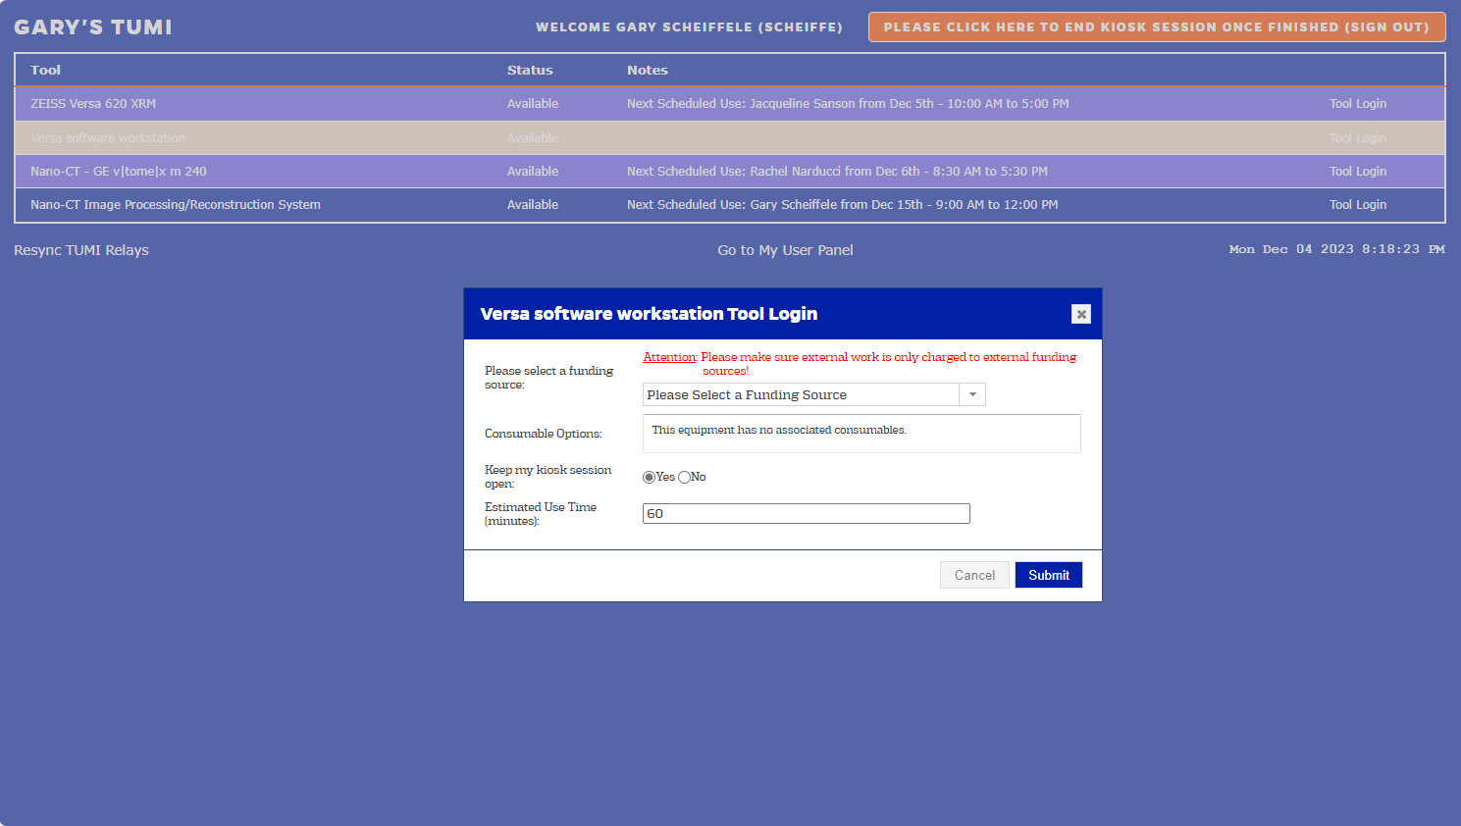
If you made a reservation, these fields will be prefilled.
If you did not make a reservation you will need to select the proper funding source to bill to.
The estimated time will default to 1 hour, you can adjust this as needed.
** Remember: you can always end a reservation early without penalty, and so long as no one else has a conflicting reservation you can stay beyond your estimated end time.

Slide 26
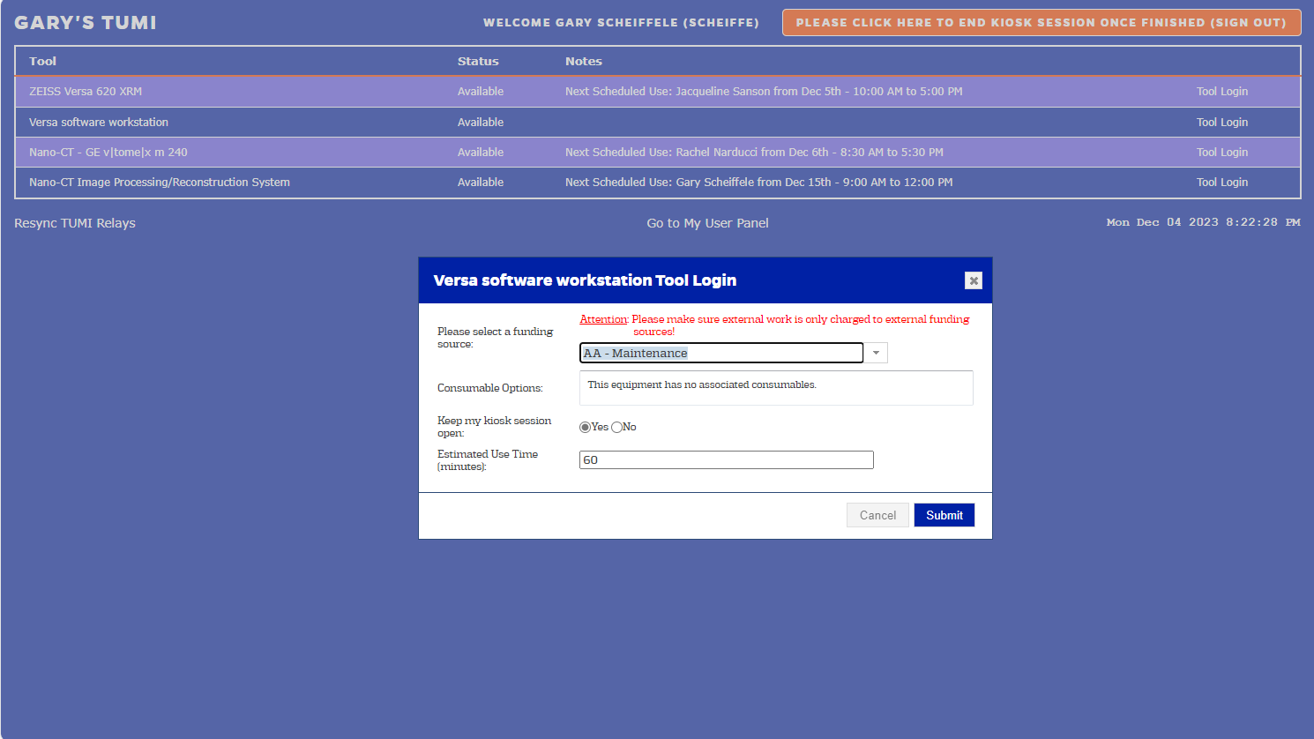
If you need to log into more than one line for your process, select YES here to keep the TUMI session logged in to select another line.

Slide 27
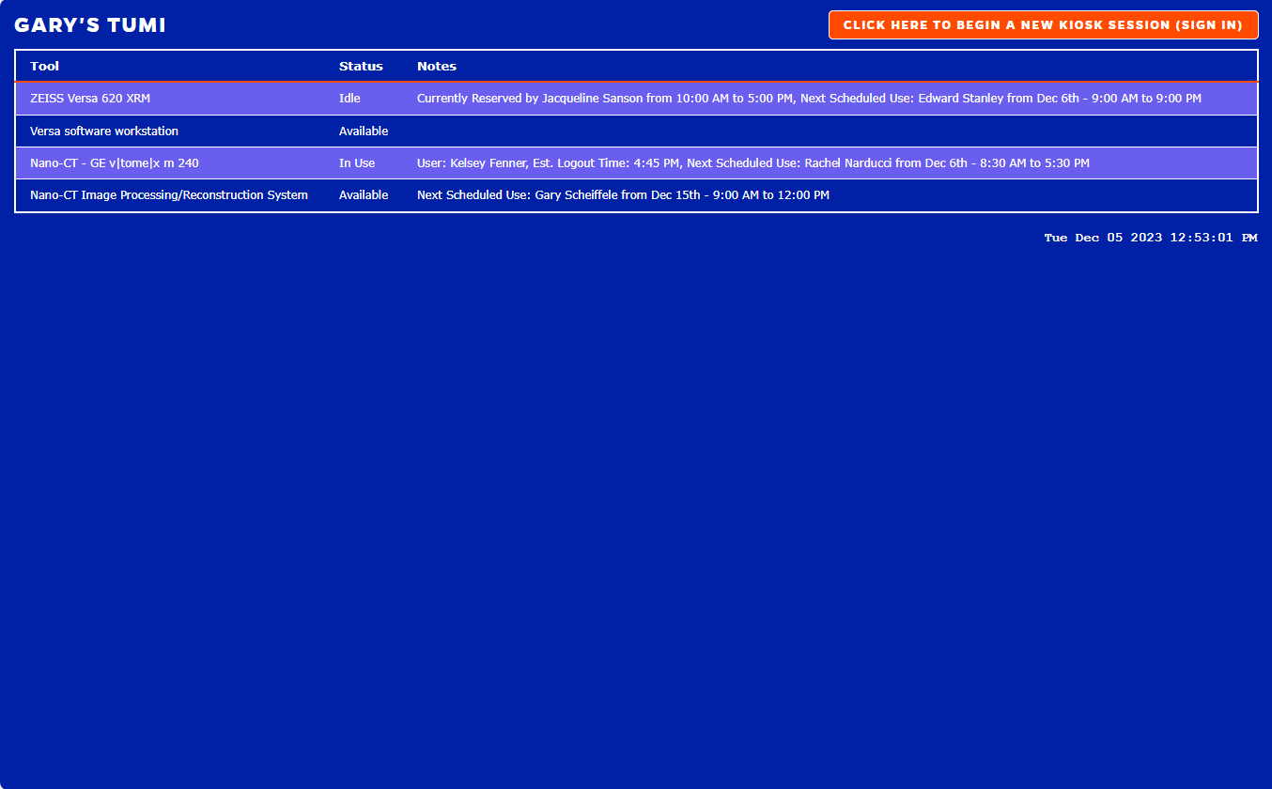
Idle indicates a tool has been reserved at this time but is not yet actually in use. In general, we ask you not jump on an unused reservation immediately, but if the user with the reservation is significantly tardy you may log in and use the tool. Be prepared to relinquish the tool should the user with a reservation turn up late.
You can CANCEL a reservation from your user panel
Once a reservation has begun this option will change to STOP

Slide 28
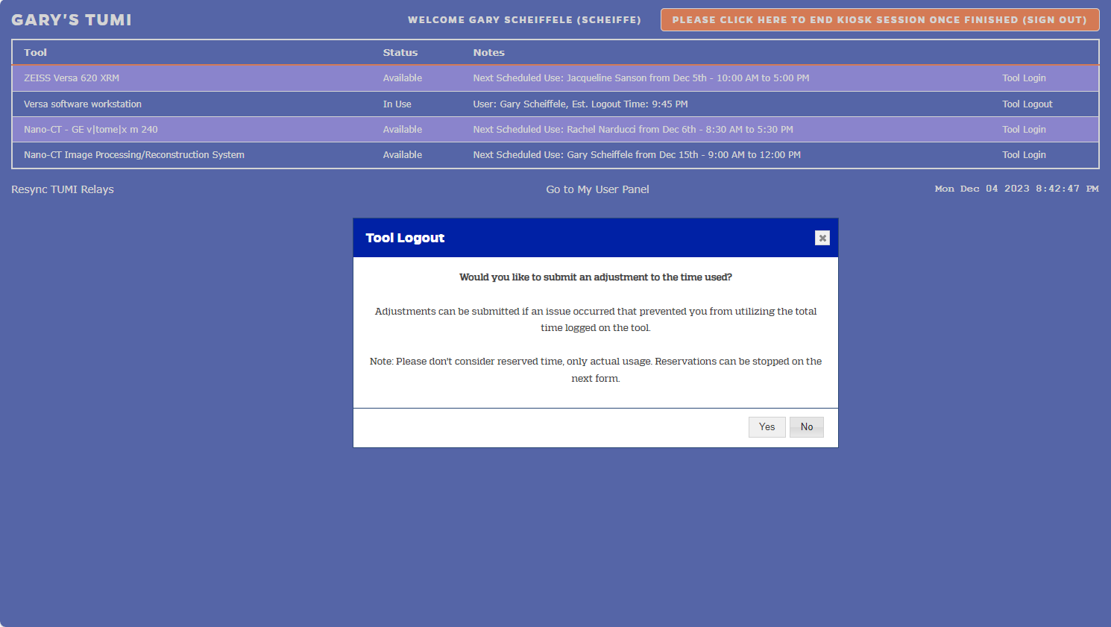
Adjustments are NOT reservation adjustments. They are to correct the actual time logged into a tool.
Adjustments are for “not my problem” problems, like computer issues, or analysis ending after hours when access is prohibited. You (your PI) should not have to pay for time we spend fixing a tool. We do not adjust time off for problems within your control (i.e. choosing to leave the lab for a meeting).

Slide 29
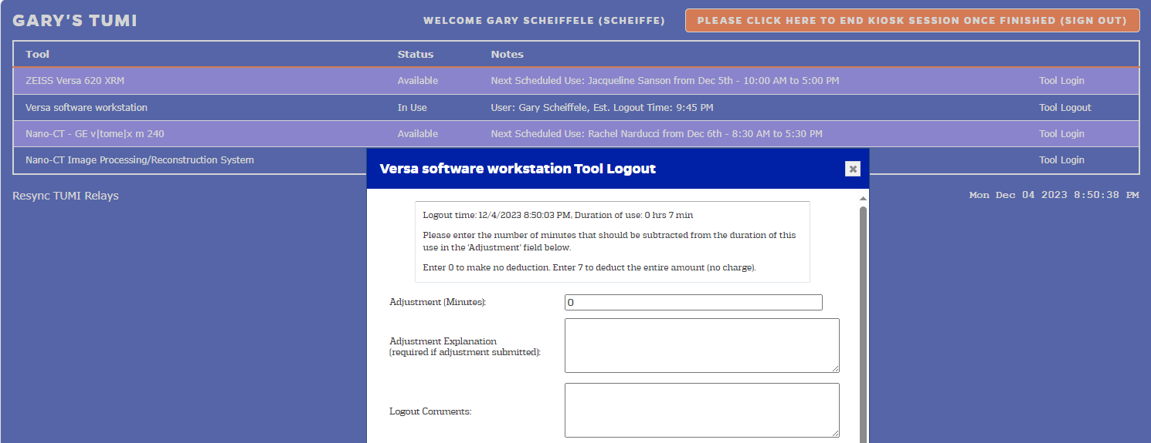
By how many minutes should the time used be reduced?
What was the issue? Who helped?
Optional session notes
ALWAYS include the name of the staff member who assisted you in the description in addition to the amount of time you are asking to have removed from your bill.
If run ended after hours, include the actual end time of the run in your description.

Slide 30
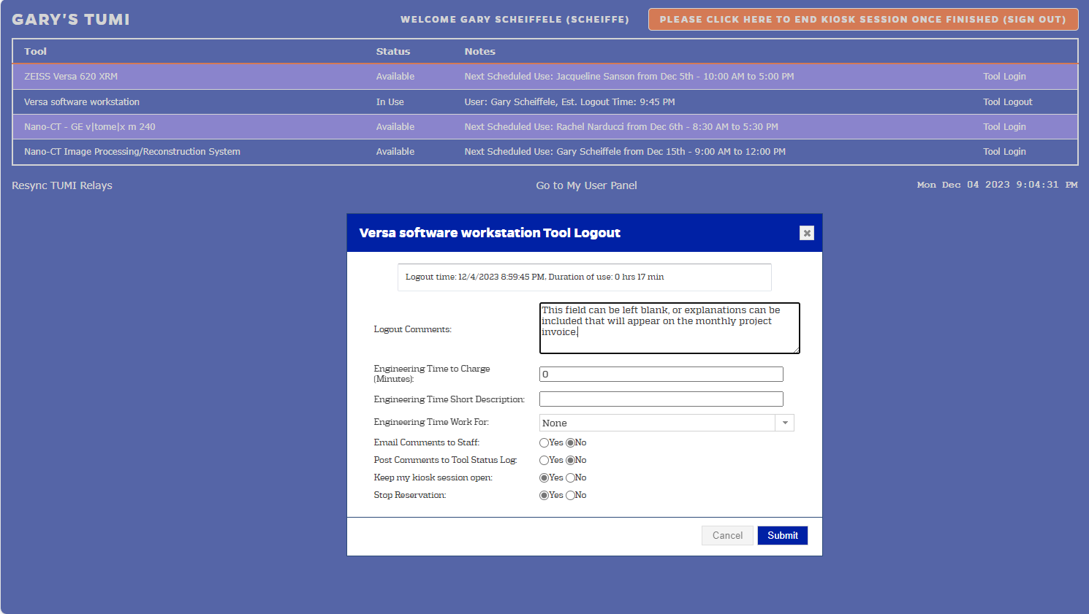
Total Use, this is what determines the charge for the session, rounded up to the next 15 minute interval.
Message box to link a note to the session. (This note may be included in the project invoice.)

Slide 31

Select Yes to alert other tool users to potential problems by posting the logoff comment note to the status log. (e.g., starting a cryo cycle, or unresolved issue preventing some use)
Selecting Yes will send the note above to all NRF staff.
Staff only sees this note if you select YES here. Otherwise, you are talking to the database.

Slide 32

Quickly log in/out of other equipment by keeping your session open.
Did you not use all your reserved time?
No problem, the default “YES” will end your reservation, making the tool available to other users.
Select “NO” to ensure you are logged off the TUMI after submitting your logout from the tool. (Your session will auto log off after a few minutes of inactivity.)

Slide 33
    REMEMBER—IF YOU SEE THE WHITE STROBE LIGHTS FLASH IN THE AREA OF THE BUILDING THAT YOU ARE WORKING—IMMEDIATELY EVACUATE.
    Finally, staff is here to help!
    If you have a question, please ask!
Welcome to the NRF

